Slide 1
Linking HTF haplotypes to O-antigen using local assembly and k-mer analysis
jiajun

Slide 2
Questions:
1. Are the isolates that break the expected O-antigen–HTF group association pattern authentic?
2. Is there evidence of co-infection among our historical herbarium-derived ATUE5 genomes?

Slide 3
Questions:
1. Are the isolates that break the expected O-antigen–HTF group association pattern authentic?

Slide 4
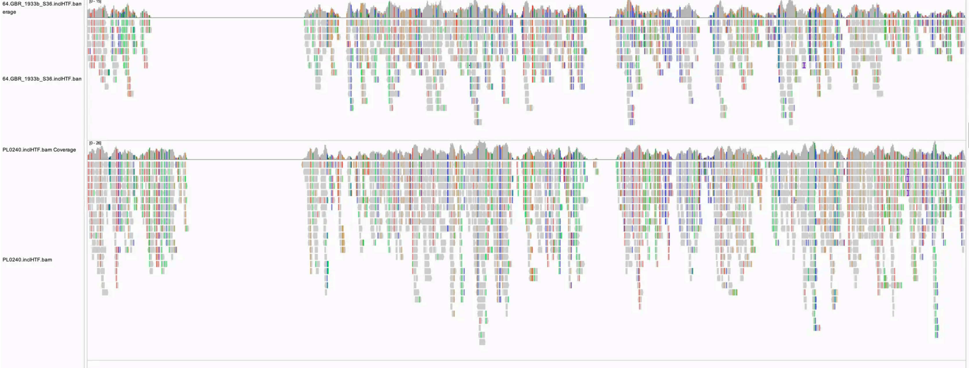
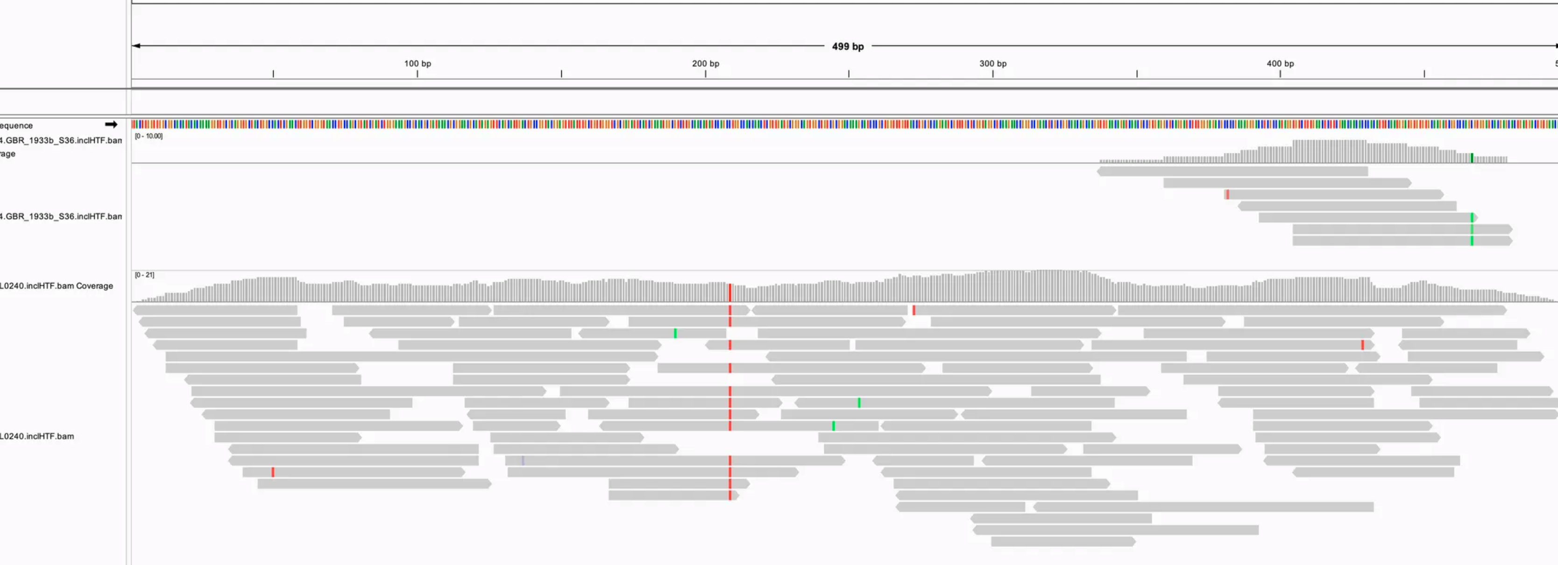
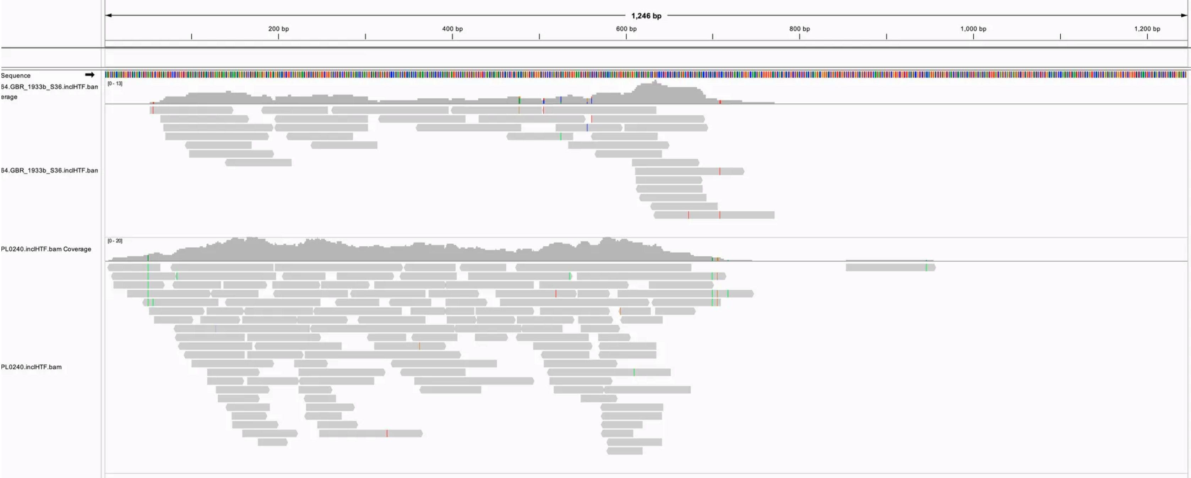
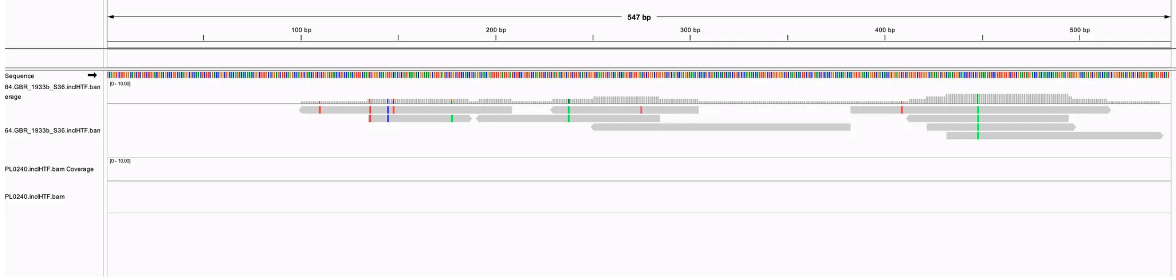
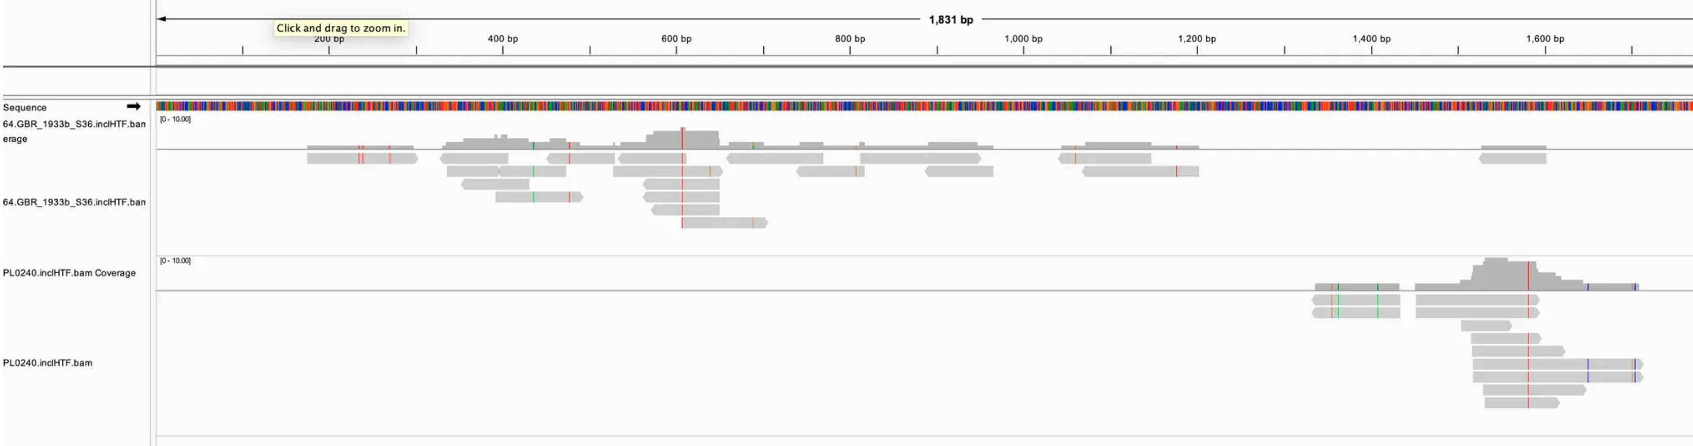
PL0240 is a true exception, while 64.GBR_1933b_S36 links HTF_p7.G11 with O-antigen absence with uncertainty.
Tailocin 1-18057 alignment
PL0240
64.GBR_1933b_S36
HTF kmer distribution
TFA and HTF alignment
TFA_p21.F9 1-498
HTF_p21.F9 1-1245
PL0240
TFA_p21.F9 1-498
HTF_p21.F9 1-1245
64.GBR_1933b_S36
TFA_p7.G11 1-546
HTF_p7.G11 1-1830
Notes:
add o-antigen, give a confidence matrix of the TFA and HTF

Slide 5
Questions:
2. Is there evidence of co-infection among our historical herbarium-derived ATUE5 genomes?

Slide 6
Three historical isolates show a two-peak k-mer depth pattern, suggesting potential co-infection.
If no co-infection:
Notes:
blob cluster seqs in terms of kmer depth and gc content, gc content like this distribution, supp 3 all the isolate HTF with wg kmer...
If no coinfection first,
Then PL0059… only the background first then overlap….,
Three slides, one for each isolate
Why coinfecton.. PL0240 then this slides

Slide 7
Three historical isolates show a two-peak k-mer depth pattern, suggesting potential co-infection.
Statistic test pipeline to see how diverse /coinfection of one sample from metagenome (like herbarium), to see how to determine which is dominant…
Y axis: htf proportion but not number like 21f9 10000/800 26d6 10000/15
Notes:
blob cluster seqs in terms of kmer depth and gc content, gc content like this distribution, supp 3 all the isolate HTF with wg kmer...
If no coinfection first,
Then PL0059… only the background first then overlap….,
Three slides, one for each isolate
Why coinfecton.. PL0240 then this slides

Slide 8
Three historical isolates show a two-peak k-mer depth pattern, suggesting potential co-infection.
HTF unique kmer count and co-infection potential of three historical samples:
PL0080 Double check p21.F9 and p26d6, the result is f9 but d6 has more power…
Show local alignment as well? See the coverage prop…
In principle the local assembly is more convincing since we use assembly which should have assembled the most frequent sample
Notes:
blob cluster seqs in terms of kmer depth and gc content, gc content like this distribution, supp 3 all the isolate HTF with wg kmer...
If no coinfection first,
Then PL0059… only the background first then overlap….,
Three slides, one for each isolate
Why coinfecton.. PL0240 then this slides

Slide 9
Three historical isolates show a two-peak k-mer depth pattern, suggesting potential co-infection.
HTF unique kmer count and co-infection potential of three historical samples:
Notes:
blob cluster seqs in terms of kmer depth and gc content, gc content like this distribution, supp 3 all the isolate HTF with wg kmer...
If no coinfection first,
Then PL0059… only the background first then overlap….,
Three slides, one for each isolate
Why coinfecton.. PL0240 then this slides

Slide 10
Questions:
Q1: Are the isolates that break the expected O-antigen–HTF group association pattern authentic?
A1: PL0240 is a true exception, while 64.GBR_1933b_S36 not sure.
Q2: Is there evidence of co-infection among our historical herbarium-derived ATUE5 genomes?
A2: Three historical isolates show a two-peak k-mer depth pattern, suggesting potential co-infection.

Slide 11
Thank you

Slide 12
Heterozygosity
Potential coinfection identified by kmer distribution
No coinfection

